Slide 1

Building Software with AI Assistants
Benefits and Limitations
Yahya Emir Soyer
2694388 - ENG 211
Notes:
[Target 0:35] Good afternoon everyone. My name is Yahya Emir. Let me start with something that surprised even me. Last month I published a working website on the internet. I wrote almost none of its code myself. An AI assistant helped me at every step. Today I will show you what these tools do well, and where they still fail.

Slide 2
Outline
• What AI assistants do well
• Where they still fall short
2
Notes:
[Target 0:20] My talk has two main points. First, AI assistants now help at every step of building software. Second, they still make hidden mistakes, so every answer needs human checking. Let us begin with a simple picture of how software is made.

Slide 3
Building software has four steps
1
Write
the code
2
Organize
the changes
3
Publish
it online
4
Repair
the mistakes
84%
of developers use or plan to use AI tools in their work
(Stack Overflow, 2025)
3
Notes:
[Target 0:30] Many people think building software means typing code all day. In reality there are four everyday steps. You write the instructions. You organize your changes so nothing gets lost. You publish the program on the internet. And you repair the mistakes that appear. According to Stack Overflow's 2025 survey of developers, 84 percent use or plan to use AI tools in their work.

Slide 4
AI now helps at every step
• Write: it drafts routine code in seconds
• Organize: it explains and tracks the changes
• Publish: it gives clear guidance, step by step
• Repair: it finds and fixes many bugs
4
Notes:
[Target 0:55] So what do these assistants actually do well? At the writing step, they draft routine code in seconds. At the organizing step, they explain what changed and keep the history clean. At the publishing step, they give clear guidance, so a beginner does not get stuck. And at the repair step, they find and fix many bugs. In my own project, one assistant helped me with all four steps. That was impossible only a few years ago.

Slide 5
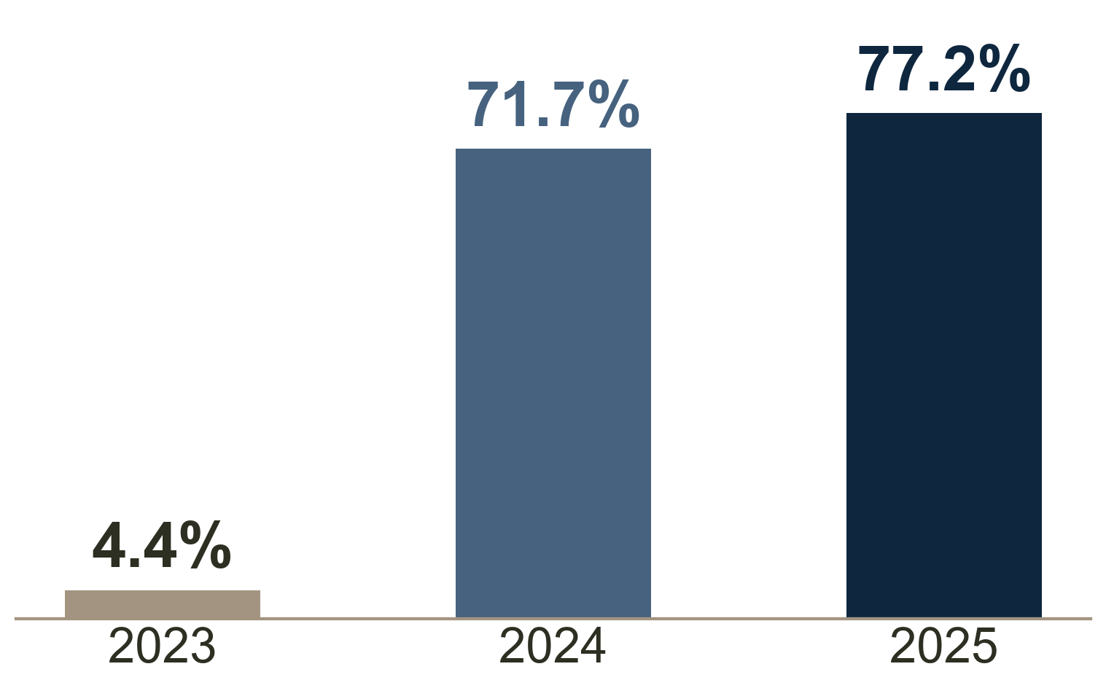
The repair skill improved very fast
Figure 1
AI results on a standard test of real software bugs
• The test: real bugs taken from real software projects
• In 2023, AI systems fixed only 4.4%
• One year later they fixed 71.7%
• By 2025: close to human performance
(Stanford University, 2026)
5
Notes:
[Target 1:15] Let me show you how fast the repair skill improved. Researchers built a standard test from real bugs taken from real software projects. This chart shows the share of those bugs that AI systems could fix on their own. In 2023, only 4.4 percent. One year later, 71.7 percent. And by 2025, more than 77 percent. According to Stanford University's AI Index reports, that level is close to human performance on this test, and it is still climbing this year. In short, this skill went from almost useless to almost human level in two years.

Slide 6
AI still makes hidden mistakes
• AI answers are often almost right, and that hides the mistakes
• 66% of developers name this as their top frustration
• 46% distrust AI accuracy, while only 33% trust it
• Every suggestion still needs human checking
6
Notes:
[Target 0:55] But there is another side. The same survey found a serious trust problem. The top frustration, named by 66 percent of developers, is that AI answers are almost right. Almost right is dangerous, because the mistake is hidden inside an answer that looks correct. And here is the surprising part. More developers distrust AI accuracy, 46 percent, than trust it, 33 percent. So the people who use these tools every day are also the people who check every suggestion.

Slide 7
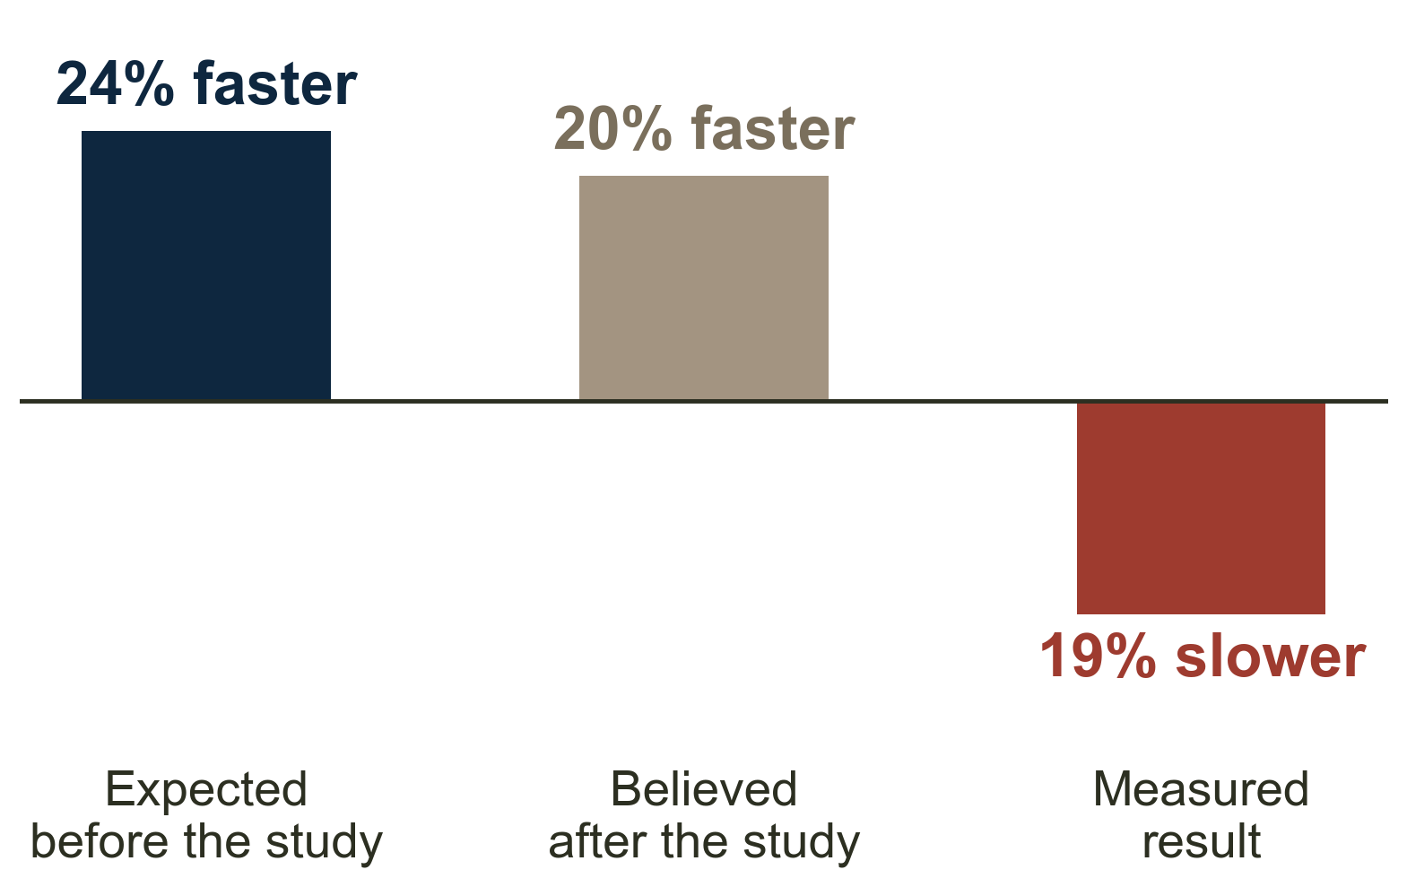
Feeling faster is not being faster
Figure 2
Expected, believed, and measured speed with AI
• The study: 16 experienced developers, 246 real tasks
• They believed AI made them about 20% faster
• Measured result: 19% slower
(METR, 2025)
7
Notes:
[Target 1:15] In 2025, a research group called METR ran a careful experiment. Sixteen experienced developers worked on 246 real tasks from their own projects. For each task, the rules decided randomly if AI was allowed. Look at the chart. Before the study, the developers expected AI to make them 24 percent faster. After the study, they believed it had made them 20 percent faster. The measured result was the opposite. They were 19 percent slower with AI. One study is not the final word, and beginners often gain more than experts. But the lesson is clear. Feeling faster is not proof of being faster. One more update. METR repeated this experiment in early 2026 with newer tools. The slowdown became smaller, but people still felt faster than the measurement showed. The lesson did not change.

Slide 8
Conclusion
• AI assistants now help at all four steps of building software
• The largest gains: routine writing and repairs
• The limits: hidden mistakes and false confidence
AI can help build the whole product. It still needs a person who understands what they are building.
8
Notes:
[Target 0:50] Let me summarize. AI assistants now help at all four steps of building software, and the repair skill improved the most, from 4.4 percent in 2023 to close to human performance by 2025. At the same time, their answers are often almost right, which hides mistakes, and the speed experiment showed that feeling faster is not proof of being faster. So every answer still needs a human check. Here is the thought I want to leave you with. AI can help build the whole product. It still needs a person who understands what they are building.

Slide 9
References
METR. (2025). Measuring the impact of early 2025 AI on experienced open source developer productivity (arXiv:2507.09089). arXiv. https://arxiv.org/abs/2507.09089
Stack Overflow. (2025). 2025 developer survey. https://survey.stackoverflow.co/2025/
Stanford University. (2026). Artificial intelligence index report 2026. Stanford Institute for Human Centered Artificial Intelligence. https://hai.stanford.edu/ai-index/2026-ai-index-report
Both charts were made by the presenter using the data sources above.
10
Notes:
Keep this slide on the screen during the question part.

Slide 10
Thank you.
Any questions?
9
Notes:
[Target 0:10] Thank you very much for listening. I am happy to take your questions.
Pocket answers:
1. Which tools did you use? General assistants such as ChatGPT, and coding assistants built into editors. I kept tool names out of the talk to keep it simple.
2. Will AI replace programmers? The evidence today says it changes the job more than it removes it. Someone still has to check the work, give direction, and take responsibility.
3. Why were the experts slower? They knew their projects very well, so reviewing AI suggestions cost more time than writing the code themselves. Beginners usually gain more.

